Slide 1
Design Concepts and Engineering
Session 06
Course : COMP6100/Software Engineering
Effective Period : Desember 2017

Slide 2
These slides have been adapted from
Pressman, R.S. (2015). Software Engineering : A Practioner's Approach. 8th ed. McGraw-Hill Companies.Inc, Americas, New York. ISBN : 978 1 259 253157. Chapter 12,13, 14, 15, 16, 17 and 18
Acknowledgement

Slide 3
LO 2 : Explain the software engineering practices and business environment
Learning Objectives

Slide 4
Contents
Design Concept
Architecture Design
Component-Level Design
User Interface Design
Pattern-Based Design
Web Apps Design
MobileApps Design

Slide 5
Design Concept
Mitch Kapor, the creator of Lotus 1-2-3, presented a “software design manifesto” in Dr. Dobbs Journal. He said, Good software design should exhibit:
  Firmness: A program should not have any bugs that inhibit its function.
  Commodity: A program should be suitable for the purposes for which it was intended.
  Delight: The experience of using the program should be pleasurable one.

Slide 6
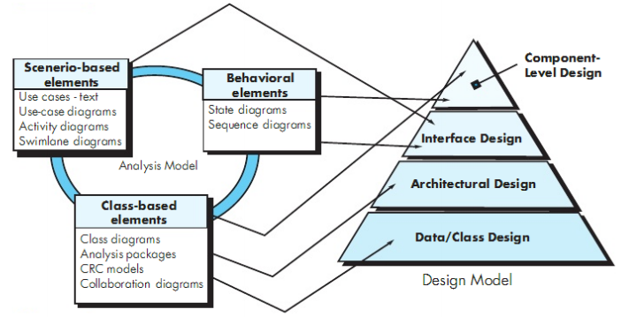
Translating the requirements model into the design model
Design Concept

Slide 7
Design Concept
Design and Quality
The design must implement all of the explicit requirements contained in the analysis model, and it must accommodate all of the implicit requirements desired by the customer.
The design must be a readable, understandable guide for those who generate code and for those who test and subsequently support the software.
The design should provide a complete picture of the software, addressing the data, functional, and behavioral domains from an implementation perspective.

Slide 8
Quality Guidelines
Design Concept
A design should exhibit an architecture
A design should be modular
A design should contain distinct representations.
A design should lead to data structures that are appropriate.
A design should lead to components that exhibit independent functional characteristics.
A design should lead to interfaces that reduce the complexity.
A design should be derived using a repeatable method.
A design should be represented using a notation that effectively communicates its meaning.

Slide 9
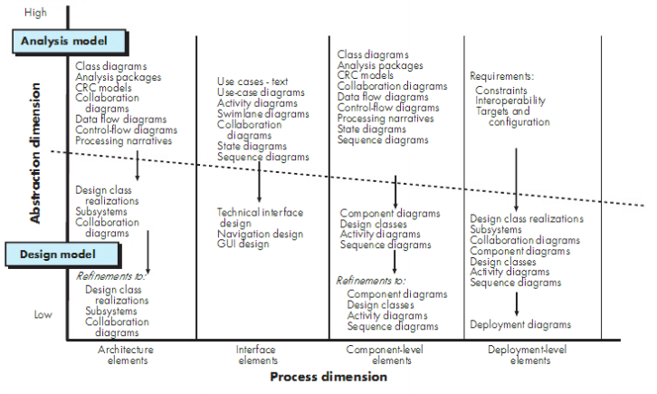
Design Model

Slide 10
Architectural Design
The architecture is not the operational software. Rather, it is a representation that enables a software engineer to:
(1) analyze the effectiveness of the design in meeting its stated requirements,
(2) consider architectural alternatives at a stage when making design changes is still relatively easy, and
(3) reduce the risks associated with the construction of the software.

Slide 11
Architectural Design
The software must be placed into context
  the design should define the external entities (other systems, devices, people) that the software interacts with and the nature of the interaction
A set of architectural archetypes should be identified
  An archetype is an abstraction (similar to a class) that represents one element of system behavior
The designer specifies the structure of the system by defining and refining software components that implement each archetype

Slide 12
Analyzing Architectural Design
Architecture Design
1. Collect scenarios.
2. Elicit requirements, constraints, and environment description.
3. Describe the architectural styles/patterns that have been chosen to address the scenarios and requirements:
• module view
• process view
• data flow view
4. Evaluate quality attributes by considered each attribute in isolation.
5. Identify the sensitivity of quality attributes to various architectural attributes for a specific architectural style.
6. Critique candidate architectures (developed in step 3) using the sensitivity analysis conducted in step 5.

Slide 13
Component-Level Design Guidelines
Component- Level Design
Components
  Naming conventions should be established for components that are specified as part of the architectural model and then refined and elaborated as part of the component-level model
Interfaces
  Interfaces provide important information about communication and collaboration (as well as helping us to achieve the OPC)
Dependencies and Inheritance
  it is a good idea to model dependencies from left to right and inheritance from bottom (derived classes) to top (base classes).

Slide 14
Component Design for WebApps
Component- Level Design
WebApp component is
  (1) a well-defined cohesive function that manipulates content or provides computational or data processing for an end-user, or
  (2) a cohesive package of content and functionality that provides end-user with some required capability.
Therefore, component-level design for WebApps often incorporates elements of content design and functional design.

Slide 15

Interface Design
Easy to learn?
Easy to use?
Easy to understand?
Typical Design Errors
lack of consistency
too much memorization
no guidance / help
no context sensitivity
poor response
Arcane/unfriendly

Slide 16
Golden Rules
Interface Design
Place the user in control
Reduce the user’s memory load
Make the interface consistent

Slide 17
Place the User in Control
Interface Design
Define interaction modes in a way that does not force a user into unnecessary or undesired actions.
Provide for flexible interaction.
Allow user interaction to be interruptible and undoable.
Streamline interaction as skill levels advance and allow the interaction to be customized.
Hide technical internals from the casual user.
Design for direct interaction with objects that appear on the screen.

Slide 18
Reduce the User’s Memory Load
Interface Design
Reduce demand on short-term memory.
Establish meaningful defaults.
Define shortcuts that are intuitive.
The visual layout of the interface should be based on a real world metaphor.
Disclose information in a progressive fashion.

Slide 19
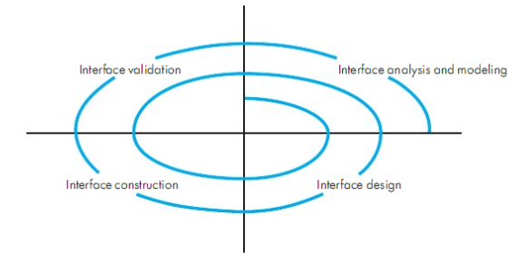
The user interface design process
Interface Design

Slide 20
Design Issues
Interface Design
Response time
Help facilities
Error handling
Menu and command labeling
Application accessibility
Internationalization

Slide 21
Pattern-Based Design
Effective Patterns
Coplien [Cop05] characterizes an effective design pattern in the following way:
  It solves a problem: Patterns capture solutions, not just abstract principles or strategies.
  It is a proven concept: Patterns capture solutions with a track record, not theories or speculation.
  The solution isn't obvious: Many problem-solving techniques (such as software design paradigms or methods) try to derive solutions from first principles. The best patterns generate a solution to a problem indirectly--a necessary approach for the most difficult problems of design.
  It describes a relationship: Patterns don't just describe modules, but describe deeper system structures and mechanisms.
  The pattern has a significant human component (minimize human intervention). All software serves human comfort or quality of life; the best patterns explicitly appeal to aesthetics and utility.

Slide 22
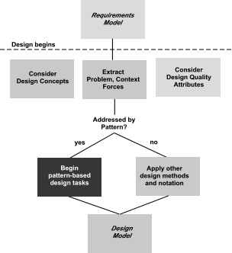
Pattern-Based Design
Pattern-Based Design in Context

Slide 23
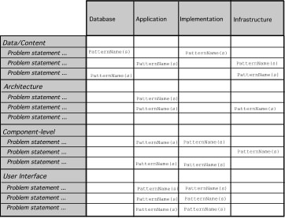
Pattern-Based Design
Pattern Organizing Table

Slide 24
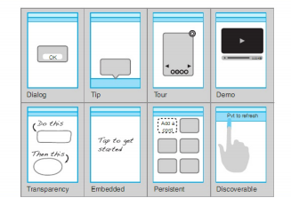
Pattern-Based Design
Example of mobile invitation patterns

Slide 25
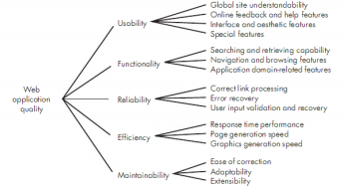
WebApp Design
Quality requirements tree

Slide 26
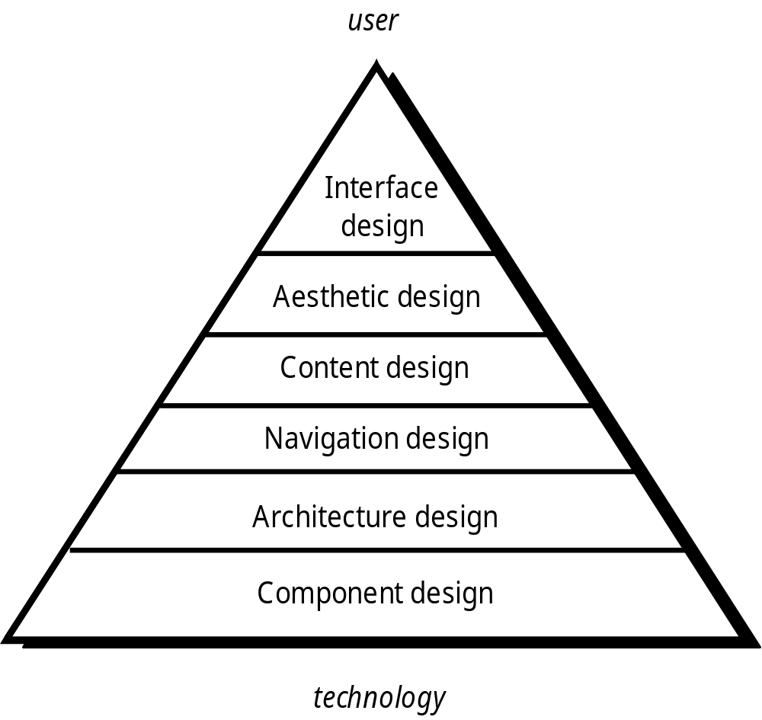
WebApp Design
Design Pyramid for WebApps

Slide 27
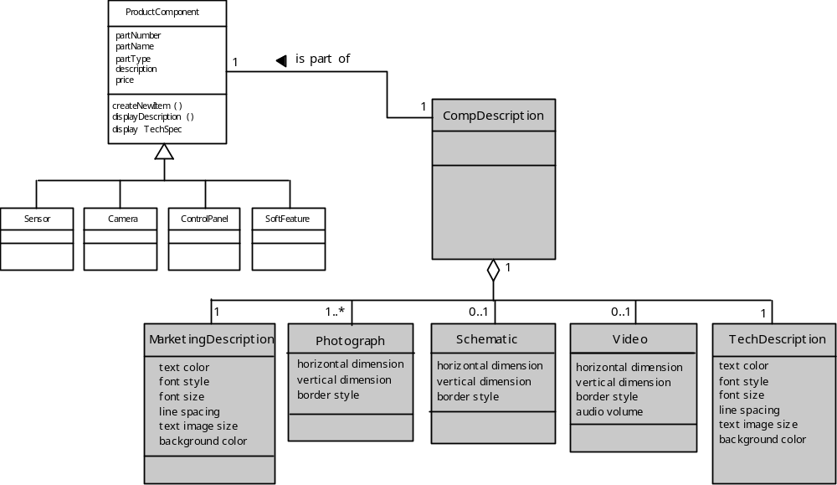
WebApp Design
Design of Content Objects

Slide 28
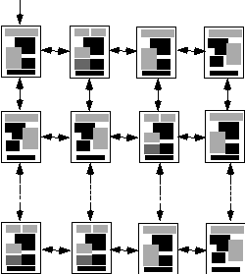
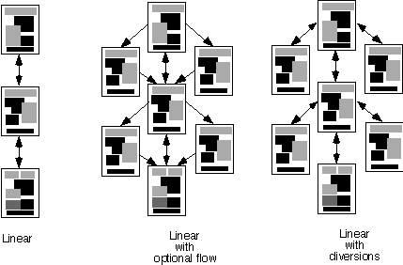
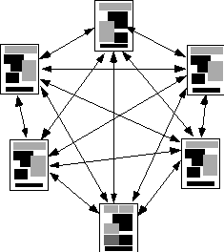
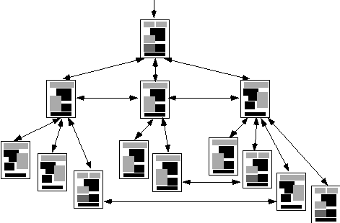
WebApp Design
Content Architecture
Grid
structure
Linear
Linear with
diversions
Linear with
Optional flow
Grid Structure
Hierarchical structure
Network structure

Slide 29
MVC Architecture
WebApp Design
The model contains all application specific content and processing logic, including
  all content objects
  access to external data/information sources,
  all processing functionality that are application specific
The view contains all interface specific functions and enables
  the presentation of content and processing logic
  access to external data/information sources,
  all processing functionality required by the end-user.
The controller manages access to the model and the view and coordinates the flow of data between them.

Slide 30
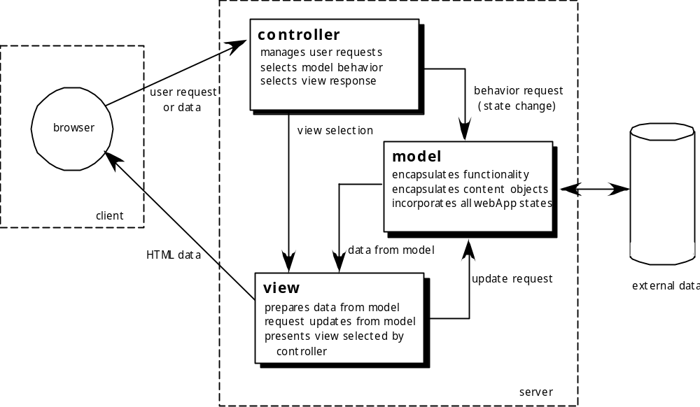
MVC Architecture
WebApp Design

Slide 31
WebApp Design
MVC Architecture - Navigation Design
Begins with a consideration of the user hierarchy and related use-cases
  Each actor may use the WebApp somewhat differently and therefore have different navigation requirements
As each user interacts with the WebApp, she encounters a series of navigation semantic units (NSUs)
  NSU—“a set of information and related navigation structures that collaborate in the fulfillment of a subset of related user requirements”

Slide 32
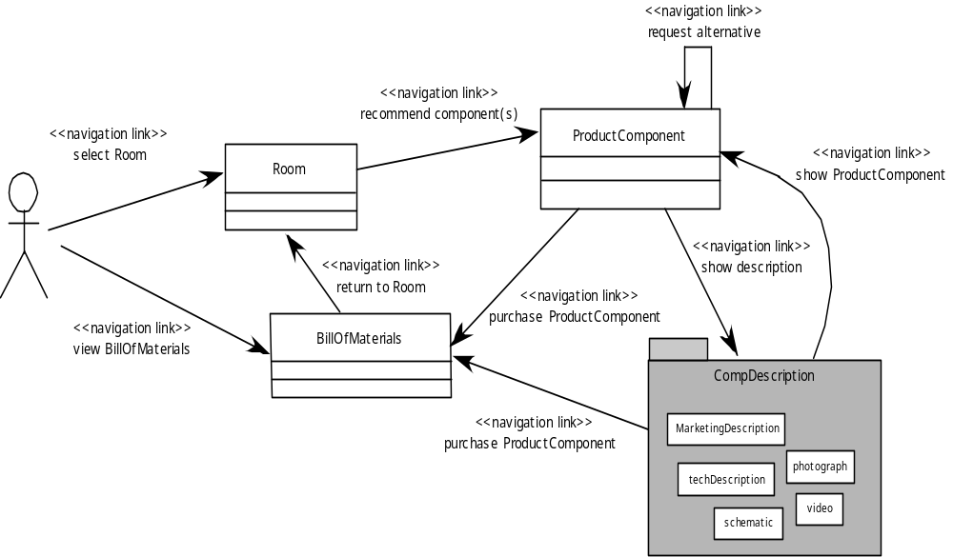
WebApp Design
Creating an NSU

Slide 33
WebApp Design
Navigation Syntax
Individual navigation link—text-based links, icons, buttons and switches, and graphical metaphors..
Horizontal navigation bar—lists major content or functional categories in a bar containing appropriate links. In general, between 4 and 7 categories are listed.
Vertical navigation column
  lists major content or functional categories
  lists virtually all major content objects within the WebApp.
Tabs—a metaphor that is nothing more than a variation of the navigation bar or column, representing content or functional categories as tab sheets that are selected when a link is required.
Site maps—provide an all-inclusive tab of contents for navigation to all content objects and functionality contained within the WebApp.

Slide 34
MobileApp Design
Developing MobileApps
Formulation
Planning
Analysis
Engineering
Implementation and Testing
User Evaluation

Slide 35
MobileApp Design
User Interface Design
Is the user interface consistent across applications ?
Is the device interoperable with different network services ?
Is the device acceptable in term of stakeholder values in the target market area ?

Slide 36
MobileApp Design
MobileApp Design – Best Practices
Some important consideration when designing mobile touch screen applications listed by Schumacher include :
Identify your audience
Design for context of use
There is a fine line between simplicity and laziness
Use the platform as an advantage
Make scrollbars and selection highlighting more salient
Increase discoverability of advanced functionality
Use clear and consistent labels
Clever icons should never be developed at the expense of user understanding
Support user expectations for personalization
Long scrolling forms trump multiple screens on mobile devices

Slide 37
References
Pressman, R.S. (2015). Software Engineering : A Practioner's Approach. 8th ed. McGraw-Hill Companies.Inc, Americas, New York. ISBN 978 1 259 253157.
Introduction to Software Architecture, http://www.youtube.com/watch?v=x30DcBfCJRI
Component-based game engine, http://www.youtube.com/watch?v=_K4Mc3t9Rtc
Software design pattern, http://www.youtube.com/watch?v=ehGl_V61WJw

Slide 38
Q & A

